Slide 1
Bundle 8 Test Review

Slide 2
The test calls scale factor 3:5 or a similar form in one problem. What should I do?
Find scale factor between two similar figures.
Find the coordinates of a point after dilation.
Find the ratio of the perimeters of two figures. What is the trick?

Slide 3
Find a missing side in two similar figures. The test has this several times and asks differently each time. LIKE: Find the missing side. OR What does x have to be to make the two figures similar?
What are three methods to determine Similarity?
USE the names of triangles to match up their parts.
There are 2 triangle proportionality questions. One angle bisector proportionality question.

Slide 4
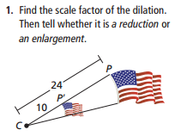
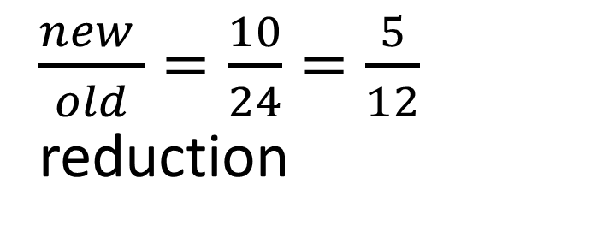
$\frac{new }{old}=\frac{10}{24}=\frac{5}{12}$ reduction

Slide 5
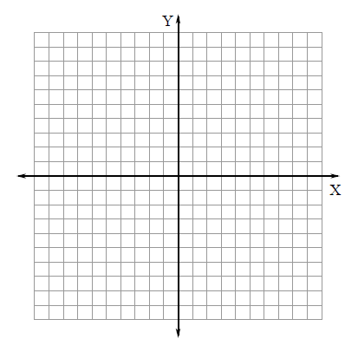

Slide 6
$\frac{new }{old}=\frac{}{}$

Slide 7
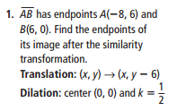

Slide 8
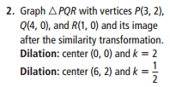

Slide 9
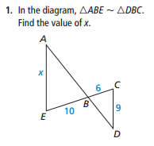
$\frac{}{}=\frac{}{}$

Slide 10
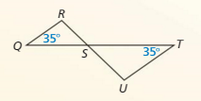
Show how these triangles are similar and write a similarity statement.

Slide 11
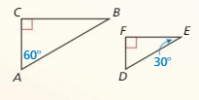
Show how these triangles are similar and write a similarity statement.

Slide 12
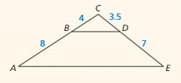
Show how these triangles are similar and write a similarity statement.

Slide 13
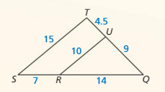
Show how these triangles are similar and write a similarity statement.

Slide 14
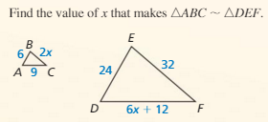

Slide 15
Show how AB is II to CD.

Slide 16
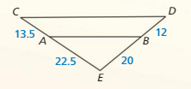
Show how AB is II to CD.

Slide 17
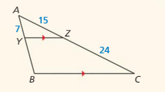
Find the length of YB

Slide 18
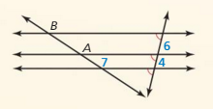
Find the length of AB

Slide 19
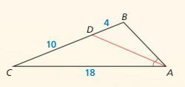
Find the length of AB

Slide 20
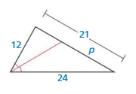
Find the length of p

Slide 22
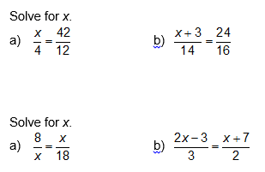

Slide 23
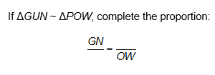

Slide 24
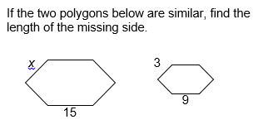

Slide 25
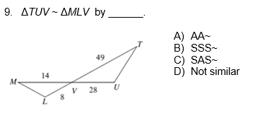

Slide 26
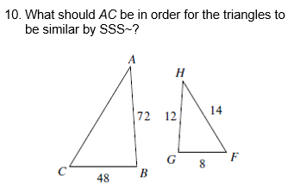

Slide 27
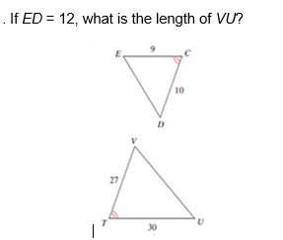

Slide 29
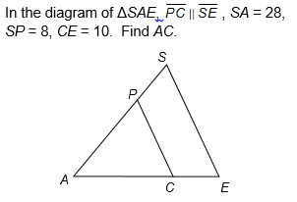

Slide 30
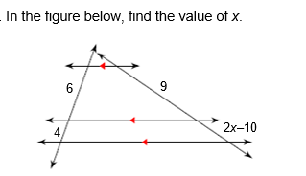

Slide 31
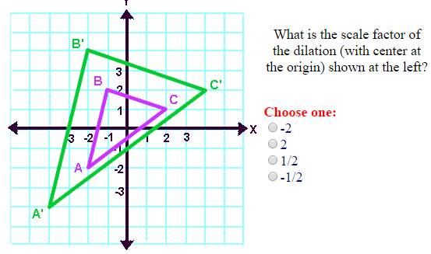

Slide 32
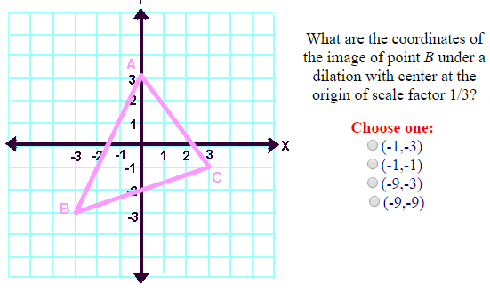

Slide 33
