Slide 1
Dilations on a Coordinate Plane and OFF the Plane

Slide 2
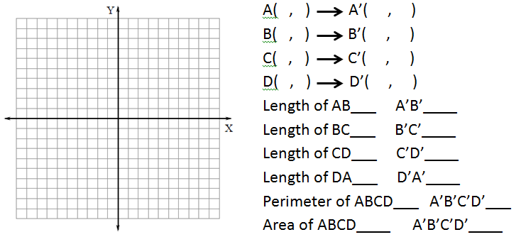
Dilate ABCD with a scale Factor of 2 (this means multiply sides or points by 2)
0 0
0 4
3 4
3 0
0 0
0 8
6 8
6 0
B’
C’
B
C
4
8
A
D
D’
A’
3
6
4
8
3
6
14units
28
12sq. units
48 sq units

Slide 3
0 2
0 6
3 4
3 0

Slide 4
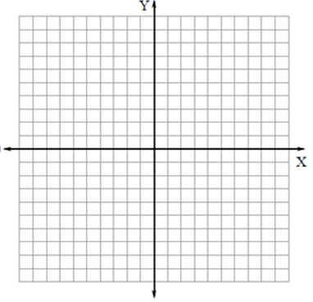
How do I figure out the scale factor?
Compare corresponding sides like this $\frac{Dilated SIDE}{Original Side}$
Rectangle ABCD with vertices A(0,0), B(0,10), C(6,10), and D(6,0) is dilated so that A’ (0,0), B’(0, 5), C’(3,5) and D’(3, 0). What is the scale factor of the dilation? Is this an enlargement or reduction?
How do I figure out if it is an ENLARGEMENT OR A REDUCTION? Look at the scale factor. Did it get bigger or smaller? SF under 1 = smaller SF above 1 = bigger

