Slide 1
Foldable
Notes:
Foldable:
Fold in half once through the center. Label the endpoints of the fold AC. Define it as DIAMETER.
Fold A to C to create a second diameter and label BD. Theses diameters are perpendicular so have students measure that.
Create a square by using the points ABCD created from the diameters.
- Use a protractor to measure angles everywhere they are created by the folds. Label the angles with their measures.

Slide 2
D
What is a DIAMETER?
Draw a diameter on the circle
Label the Diameter AC
Construct a Perpendicular Bisector on AC and label it BD
Connect the points on the circle to form a square
Help!
A
C
B

Slide 3
D
Brainstorm with your group every property you see for this square.
Four equal sides
Four 90ᵒ angles for vertices
Diagonals are perpendicular
Diagonals are equal in length
Diagonals bisect each other
Diagonals bisect the vertex angles
Opposite sides are parallel
How many triangles are created by the diagonals?
Can you classify the triangles?
Every single one is a Special Right. Measure the sides of a large and a small triangle to see the ratios on your construction.
A
C
B
$${45}^{o}$$
$$s\sqrt{2}$$
$$s$$
$${45}^{o}$$
$$s$$

Slide 4
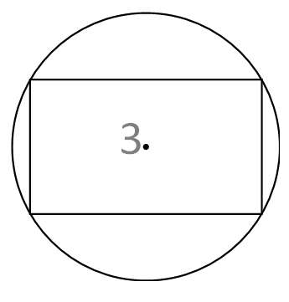
Foldable
Notes:
Foldable
Draw a diagonal of the rectangle and fold along it. Notice the lack of symmetry along the diagonal.
Draw the other diagonal of the rectangle and notice that it is also a diameter of the circle. Notice the right triangles that the diagonals form in the rectangle.
Measure any of the angles of the rectangle created by the diagonals (not 45 degrees) and label them.
The rectangle put in the circle helps one find the line(s) of symmetry. Have students find them.

Slide 5
Draw a diagonal AC
Construct a Perpendicular Bisector on AC. Are the diagonals perpendicular?
Draw the other diagonal DB and measure both diagonals.
Measure the angles formed by the diagonals at the vertices. Do the diagonals bisect the vertex angles?
D
C
A
B

Slide 6
D
C
Brainstorm all the properties of a rectangle
Four 90ᵒ Vertices
Opposite sides are congruent
Opposite sides are parallel
Diagonals are congruent and bisect each other
A
B
How many triangles are created by the diagonals?
Can you classify the triangles?

Slide 7
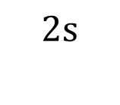
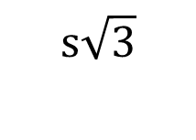


The two triangles formed by one diagonal will always be right triangles.
Sometimes, if the angles are just right, these will be Special Right Triangles.
Is there a way you could check your triangle to see if it is a Special Right?
C
D
$${60}^{o}$$
$$2s$$
$$s$$
$${30}^{o}$$
A
B
$$s\sqrt{3}$$
Notes:
Measure the s and 2s to see if the diagonal is twice the size of s
If s is fold on top of 2s it should be half it’s size

Slide 8
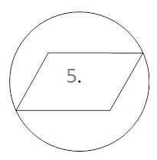
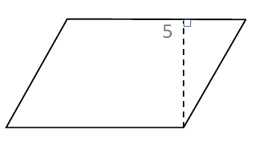
Foldable
Notes:
1st picture:
- Look at how the parallelogram fits into a circle.
Parallelogram has only two corners that can touch the circle
No lines of symmetry: can’t fold and get anything to fold on top of itself
2nd pic
Measure the consecutive angles and what do you find?
Fold an edge along itself as the teacher demonstrates.
Cut along that fold and place on the other end of parallelogram to make a rectangle(glue or tape it there) This has much to do with how area is calculated for a parallelogram.

Slide 9
D
C
Draw a diagonal AC
Draw diagonal DB
Are the diagonals perpendicular?
Brainstorm with your group to find every property you can.
Properties:
Diagonals are NOT equal and are NOT perpendicular
Diagonals bisect each other.
Opposite sides are equal and parallel
Opposite angles are congruent
Adjacent angles are supplementary
A
B

Slide 10
D
C
How do you find area of a parallelogram?
Construct a perpendicular from Point D to AB. This is the ALTITUDE (height)
Help!
A
B
Notes:
Reference foldable when talking about the area

Slide 11
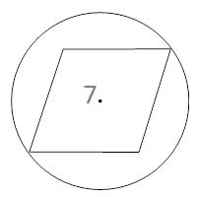
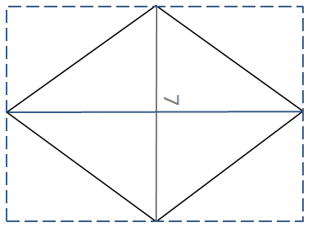
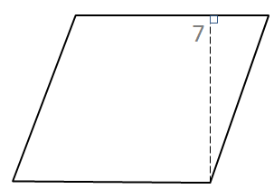
Foldable
Notes:
Foldable:
Has two lines of symmetry: two ends fold directly on top of itself
2nd pic
Cut one corner, place, then glue where it goes

Slide 12
Construct an angle bisector at angle A
Draw a diagonal AC
Construct a perpendicular bisector on AC
Brainstorm with your group to find every property you can for a Rhombus:
The diagonals are perpendicular and bisect each other
The diagonals bisect all the vertex angles
All sides are congruent and opposite sides are parallel
Opposite angles are congruent
Adjacent angles are supplementary
The triangles formed by the diagonals are right or isosceles.
D
C
Help!
A
B

Slide 13
Let’s talk about area of a Rhombus.

Slide 14
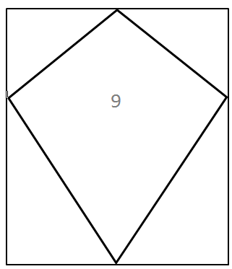
Foldable
Notes:
Foldable:
Find the lines of symmetry and fold. What are they called?
Measure angles and sides all around and label. Discuss things you observed.

Slide 15
D
Draw a diagonal AC
Construct a perpendicular bisector on AC
This is diagonal DB
Brainstorm with your group to find every property you can for a Kite:
The diagonals are perpendicular
The long diagonal bisects the short one
The long diagonal bisects ∠D and ∠B
AD ≅ DC AB ≅ BC
∠A ≅ ∠C
The diagonals form right, isosceles, and scalene triangles
A
C
B

Slide 16
Let’s talk about area.

Slide 17
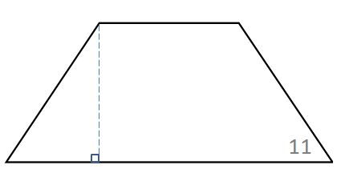
Foldable
Notes:
Foldable:
-Find any lines of symmetry and fold and label them.
-Draw or fold the diagonals.
-Measure angles, sides, and diagonals and discuss what you observe.
-Fold the long side onto itself as the teacher demonstrates. Cut off the folded triangle and tape it on the other side to create a rectangle. Area of a rectangle is L*W. How could you find the length and width of a trapezoid?

Slide 18
Draw a diagonal AC
Draw diagonal DB
Construct an altitude from Point D to segment AB
Brainstorm properties
Isosceles Trapezoid Properties:
Diagonals are equal in length
One set of opposite sides is parallel but not equal length
One set of opposite sides is not parallel and is equal length
Base angles are congruent
D
C
A
B

Slide 19
Let’s talk about area.
Averaging the bases turns the trapezoid into a rectangle with an area of L⦁W or bh.
Bh has only one base in it, but the trapezoid has 2, so we average the bases then multiply times the height.
(b₁ + b₂) h
2

Slide 20
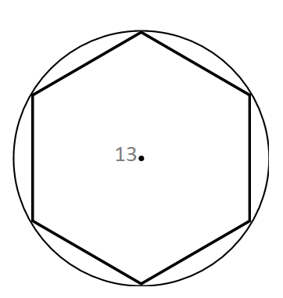
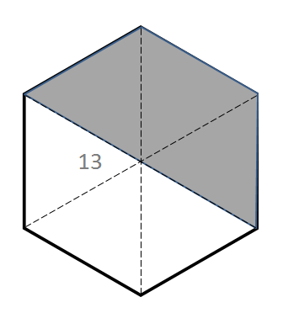
Foldable
Notes:
Foldable:
-Fold and create as many diagonals as you can. How many? Are they all the same length? Do they all pass through the center?
- What are the measures of the angles the long diagonals create in the center? What is their total? If this polygon had 8 sides, how many triangles would there be in the center? What would their angles measure? What would they total?
-Using the 3 long diagonals, cut the hexagon into 6 triangles. Can you use these triangles to create a rectangle? Once you figure this out, glue the triangles down on a sheet of paper. Knowing that the area of a rectangle is L*W, could you find the area of this hexagon?

Slide 21
F
Draw a diagonal AD
How many diagonals are there?
What kind of triangles are created by the long diagonals?
Construct a perpendicular bisector on BC.
This is an APOTHEM. It is a line from the center of a regular polygon to the midpoint of a side. It is used to find area.
A
E
B
D
C

Slide 22
Let’s talk about area.

Slide 23
Notes:
https://www.youtube.com/watch?v=YokKp3pwVFc

