Slide 1
Special Triangle Theorems
Triangle Proportionality Theorem & Angle Bisector Theorem

Slide 2
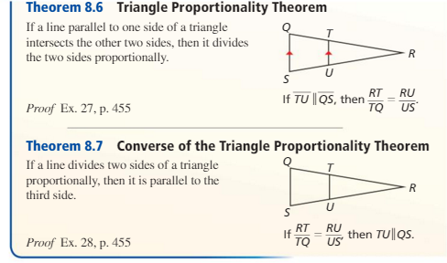

Slide 5
x

